Slide 1
{Insert your company name}
FOOTY COLOURS DAY
CELEBRATION

Slide 2
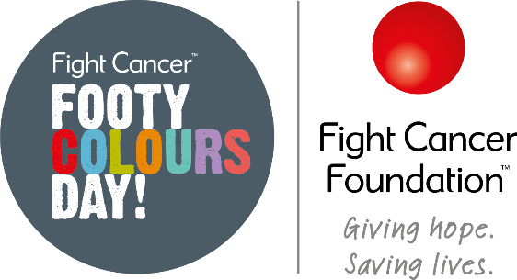
COMPETITION TIME CAST YOUR VOTES!
Category 1: Best Footy Colours Day outfit and decorations
Category 2: Best looking footy food and drink

Slide 3
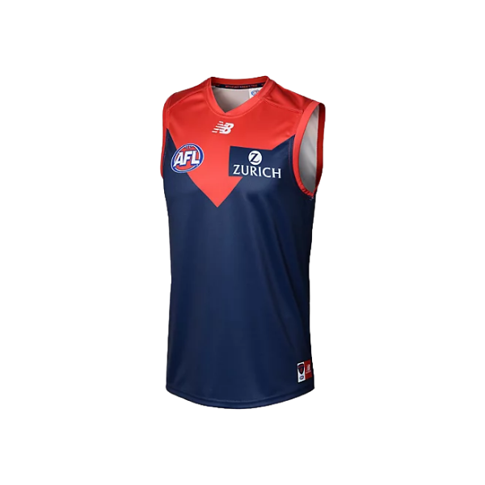
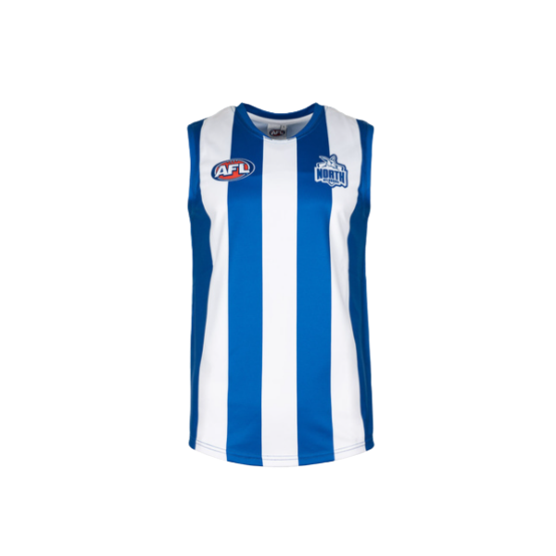
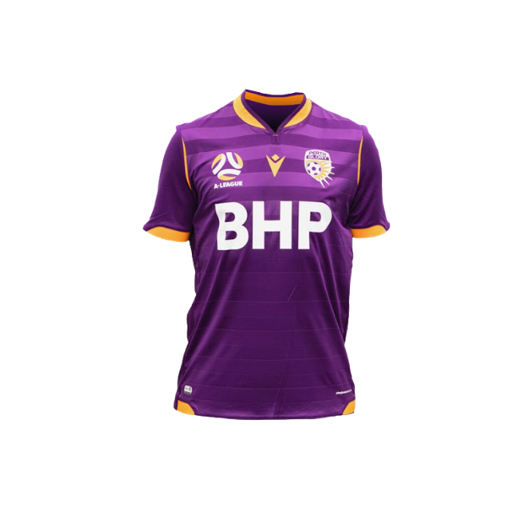
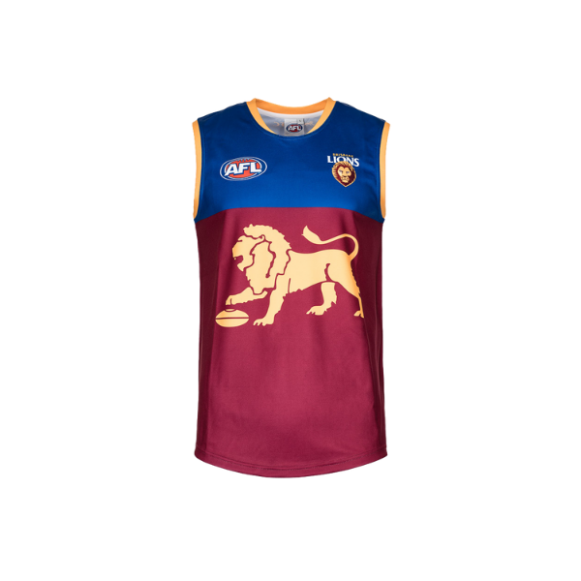
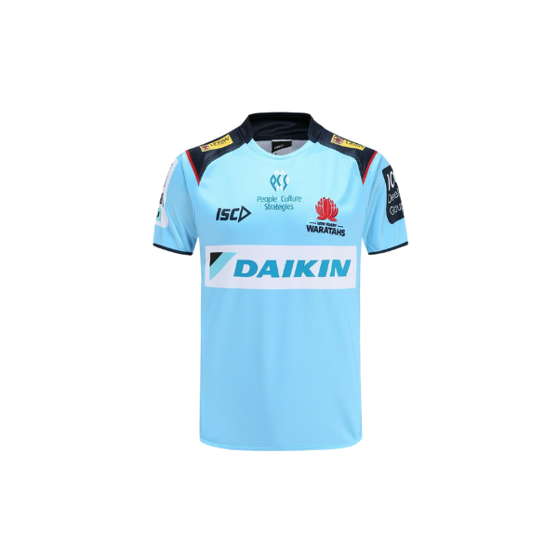
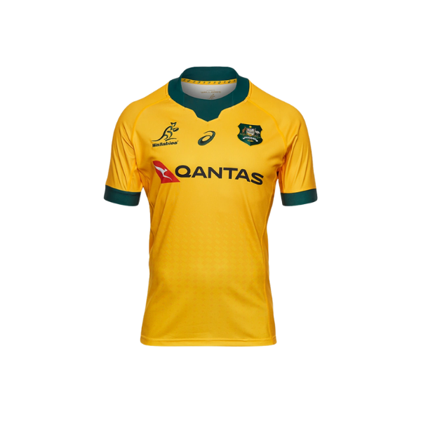
NAME THAT TEAM!
1.
2.
3.
4.
5.
6.

Slide 4
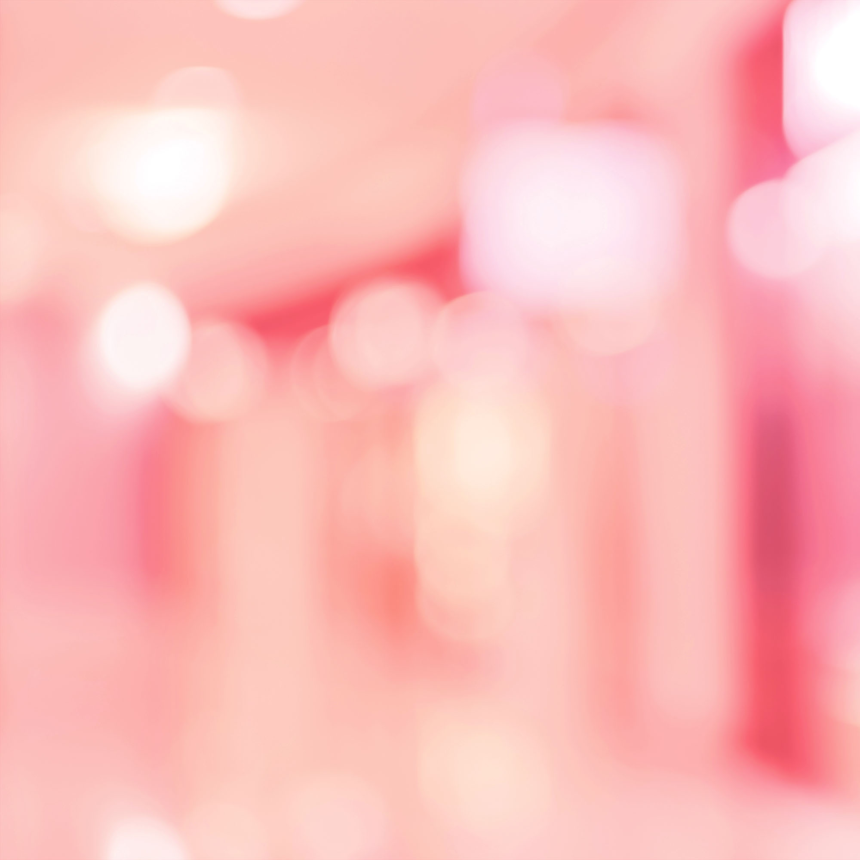
MATCH THE PLAYER TO THEIR TEAM
Renee Garing
Jack Crisp
Marcus Bontempelli
Daly Cherry-Evans
Ellie Carpenter
Corey Waddell
Justin O’Neill
Reece Hodge
Stephen Coniglio
Max Gawn
North QLD Cowboys
Manly Sea Eagles
Greater Western Sydney Giants FC
Matildas
Geelong FC
Collingwood FC
Canterbury-Bankstown Bulldogs
Melbourne FC
Bulldogs FC
Melbourne Rebels

Slide 5
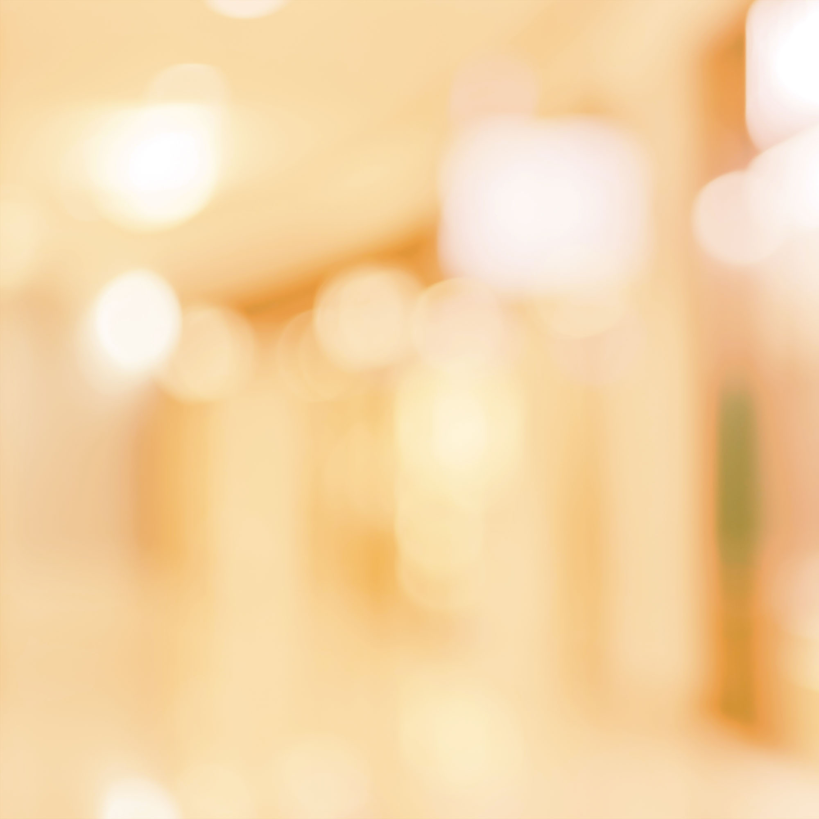
TEST YOUR GENERAL FOOTY KNOWLEDGE
What year did Aussie Rules become known as Australian Football League (AFL)?
2. Who won the gold medal at the Winter Olympics in 2002 after all four opponents crashed out on the final turn?
3. What was the name of the first Australian woman to win Wimbledon since 1980?
4. Which team has the longest active AFL/VFL premiership drought? A:Melbourne B:Port Adelaide C:Essendon D: St Kilda
5. Who is the Wallabies’ greatest ever try scorer? A:Israel Folau B: Stirling Mortlock C: David Campese D: Chris Latham
6. Who is Australia’s most capped Socceroos player? A:Tim Caholl B:Brett Emerton C: Mark Schwarzer D: Johnny Warren
7. With this majestic bird as a mascot, which Sydney based AFL team was originally called South Melbourne?
8. What colour football is used at night during an AFL match?
9. St. George have the mascot name of what?
10. Who won the 2020 NRL Grand Final?

Slide 6
FOOTY COLOURS DAY BINGO

Slide 7
G O A L

Slide 8
DON’T FORGET TO DONATE
{insert online fundraising page link here}
All funds raised through Footy Colours Day helps kids with cancer keep up with school!

